Slide 1
Designing Digital Autonomy From Dark Patterns to Safety-by-Design in AI Data Collection
Mumtaz Kynaston-Pearson
Principal Legal Counsel, Mimecast · AIGP · CIPP/E
IWD AI Safety & Governance · 14 March 2026
Notes:
Quick introduction - name, one-line role, straight into the hook.

Slide 2

"Accept All"
Raise your hand if you've tapped 'Accept All' today without reading a single word.
Was that resignation? Or design?
Notes:
Let's start with a quick show of hands. Raise your hand if, at some point today, you tapped 'Accept All' on a cookie banner or a terms & conditions update without reading a single word.
[Pause, acknowledge hands]
Keep your hand up if you also felt that small voice saying: 'They already have everything anyway. Does it even matter?’
That resignation is not an accident.
It is the intended outcome of deliberate design choices called dark patterns.
And today, I want to show you what that means — especially for women — and what we can do about it.

Slide 3
When Dark Patterns Target Women
AI-Generated Harassment
Personal data trains models that produce targeted abuse and non-consensual intimate imagery
Discriminatory Profiling
Opaque data collection enables algorithmic bias in hiring, credit, healthcare
Stalking & Doxxing
Location data, behavioural patterns extracted without genuine consent become tools for abuse
Erosion of Autonomy
When "Accept All" is the only option, digital participation becomes coerced participation
Notes:
Why does this matter specifically in an AI safety context — and specifically for women?
Dark patterns don't just harvest data. They harvest data that can then be weaponised.
[Point to each as you speak]
AI-generated harassment: the data collected through manipulative consent flows can train models that produce targeted abuse, deepfakes, and non-consensual intimate imagery.
Discriminatory profiling: opaque data collection enables algorithmic bias — in hiring, in credit decisions, in healthcare access.
Stalking and doxxing: location data, behavioural patterns, social connections — all extracted without genuine consent — become tools for abuse.
And fundamentally, erosion of autonomy. When 'Accept All' is the only realistic option, digital participation becomes coerced participation.
This is not abstract. This is a safety issue.

Slide 4
Dark Patterns: The Manipulation Toolkit
Sneaking
Hiding information in fine print or legalese
Urgency
False deadlines, "only 2 left!" pressure
Misdirection
Visual tricks drawing attention away from choices
Social Proof
Fake testimonials, inflated user counts
Obstruction
Making opt-out hard - email support, multi-step processes
Forced Action
"Agree or you can't use the service“
These aren’t accidents. They’re strategies.
Notes:
To fight dark patterns, you first need to recognise them.
Here are the six categories — based on the Nielsen Norman Group taxonomy. [Quick run-through, pointing to each]
Sneaking — hiding material terms in fine print nobody reads.
Urgency — fake countdown timers, artificial scarcity.
Misdirection — visual design that draws your eye away from the 'no' button.
Social proof — manufactured testimonials and inflated numbers.
Obstruction — want to opt out? Email this address, wait 30 days, fill out this form.
And forced action — agree to everything, or you can't use the service at all.
These are not accidents. These are deliberate strategies. And once you see them, you'll see them everywhere.

Slide 5
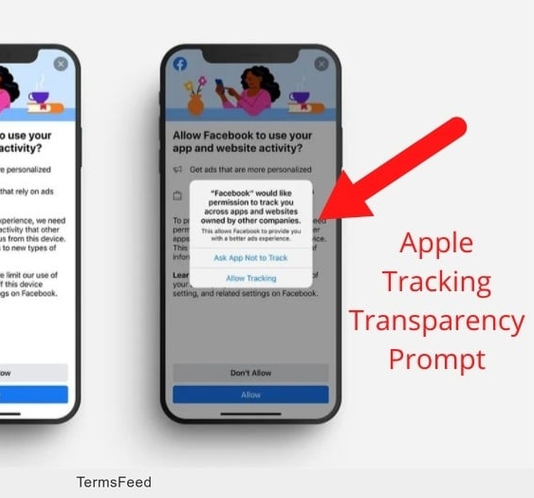
3 x Bright-Pattern Archetypes – Safety-by-design in action
Progressive Consent
Ask at the moment of need, with clear language and a real choice
Apple App Tracking Transparency. One-screen prompt, ~25% opt-in rate, no GDPR fines
Notes:
Now the good news.
There are bright patterns — design choices that give people genuine agency. Let me give you three that you can apply
1] Progressive consent. Instead of front-loading a wall of permissions, ask at the moment of need, with clear language and a real choice.
Example: Apple's App Tracking Transparency is the benchmark — a single-screen prompt that says exactly what's happening. Opt-in rates dropped to 25%. That's what real consent looks

Slide 6
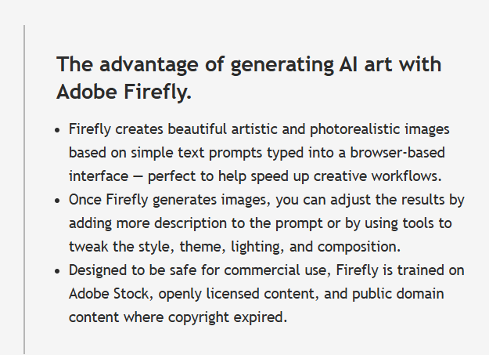

3 x Bright-Pattern Archetypes – Safety-by-design in action
Privacy Nutrition Labels
Clear, contextual disclosure at the point of interaction
Adobe Firefly. "Trained on Adobe Stock, openly licensed content"
Notes:
2] Privacy nutrition labels.
Tell users what's in the system — right there, at the point of interaction.
Example: Adobe Firefly makes it clear that it is: 'Trained on Adobe Stock and openly licensed content.' No fine print. No legalese.

Slide 7
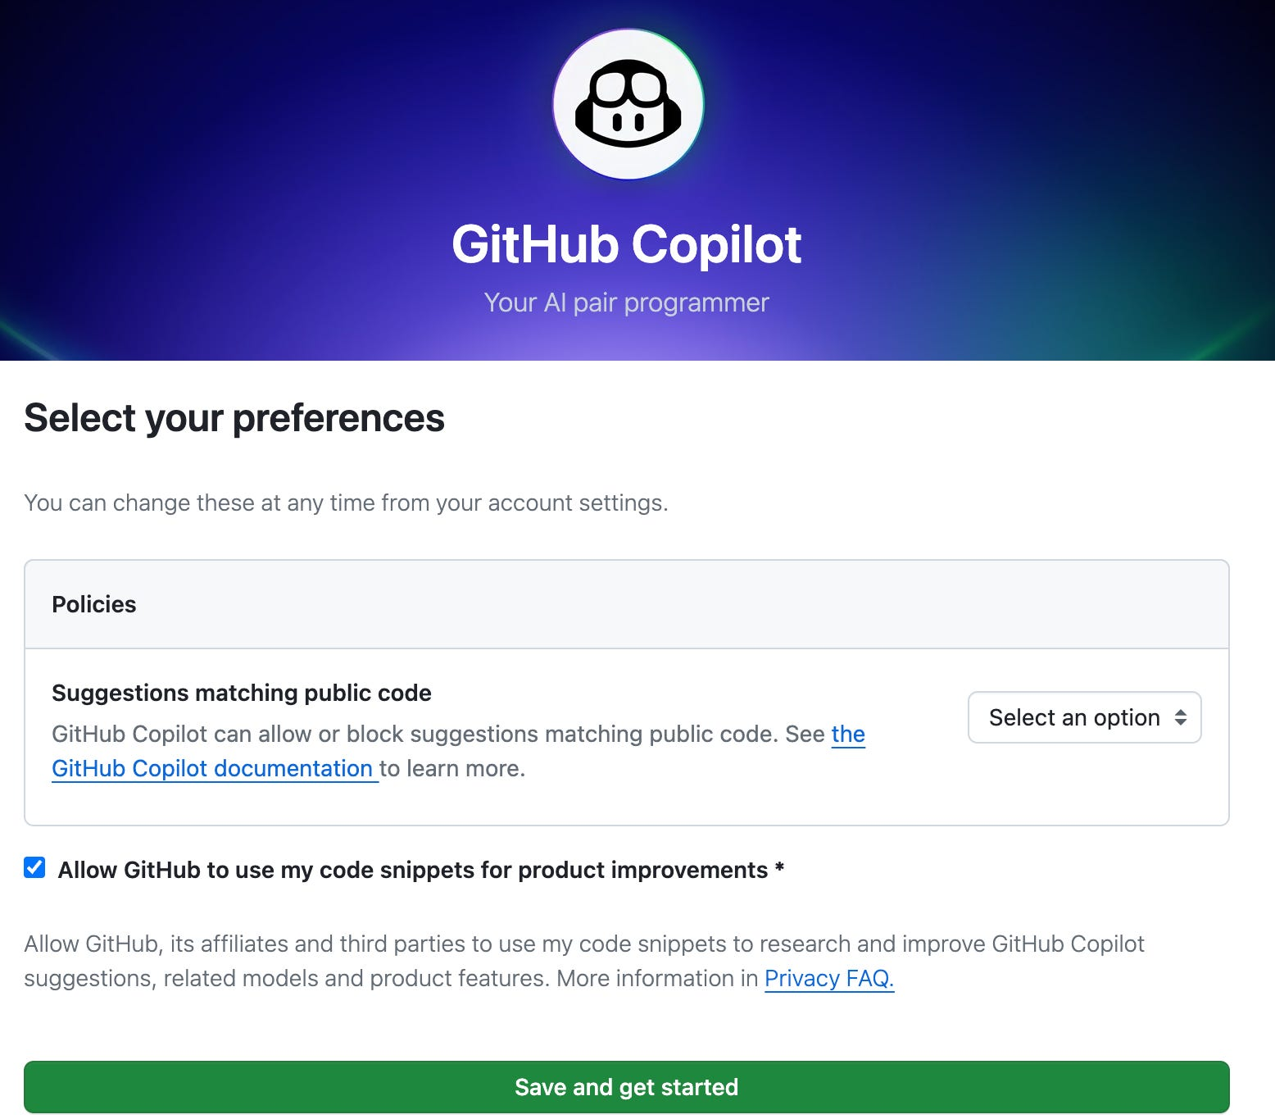
3 x Bright-Pattern Archetypes – Safety-by-design in action
Granular Toggle Matrix
Separate controls for separate purposes; privacy-protective defaults
GitHub Copilot. Two independent switches: "Share snippets" vs "Allow training“. Default off
Notes:
3] Granular toggle matrix.
Don't bundle everything into one 'improve our services' switch.
Example: GitHub Copilot gives enterprises two independent toggles — one for telemetry, one for training. Separate purposes, separate choices, default set to off.
These aren't charity. These are safety-by-design.

Slide 8
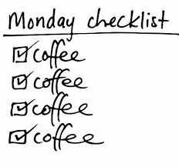
The Five-Question Audit
Your Monday Morning Checklist:
 | Question | Action
1 | Just-in-time notice? | Are users informed at the moment of collection, not buried in a policy?
2 | Real choice? | Can users decline without losing core functionality?
3 | Clear purpose? | Do users understand why data is collected and how it will be used?
4 | Retention boundaries? | Is data kept only as long as needed? Can users request deletion?
5 | Feedback channel? | If someone is harmed, is there a process to challenge or report?
One "no" = one gap to address
Notes:
I want to leave you with something you can use immediately.
Five questions to audit any AI feature, any consent flow, any data collection interface.
[Read through, pausing on each]
One: Is there just-in-time notice? Are users informed at the moment their data is collected — not just in a policy they signed months ago?
Two: Is there a real choice? Can users meaningfully decline without losing access to core functionality?
Three: Is the purpose clear? Do users understand why data is being collected and how it will be used?
Four: Are there retention boundaries? Is data kept only as long as necessary? Can users request deletion?
Five: Is there a feedback channel? If someone believes they've been harmed or unfairly profiled, is there a process?
If you answer 'no' to any of these, you've identified a gap — and potentially a liability.
This checklist works whether you're reviewing a consumer app, an enterprise AI system, or a workplace monitoring tool.

Slide 9

What You Can Do
If You Build
Adopt bright-pattern defaults. Progressive consent. Privacy-protective defaults. Test your flows against the five questions.
If You Govern
Include "consent integrity" in algorithmic impact assessments. Audit interfaces, not just policies.
If You Use
Notice the patterns. Ask questions. Demand better - as users, as employees, as citizens.
Ethical UX isn't charity. It's safety-by-design.
Notes:
So what can you do with this?
If you build AI systems — adopt bright-pattern defaults. Test your consent flows against those five questions before you ship.
If you govern or advise on AI — push for consent integrity as a governance pillar. Audit the interfaces, not just the policies.
And if you use AI systems — which is all of us — notice the patterns. Ask questions. Demand better. As users. As employees. As citizens.
We don't have to accept 'they already have everything anyway' as the design reality. We can build systems that respect human agency — that treat people as partners, not raw material.
Ethical UX isn't charity. It's safety-by-design. And it's something every person in this room can champion.

Slide 10
Thank you - Questions?
Mumtaz Kynaston-Pearson
LinkedIn: /in/mumtaz-kynaston-pearson-6524b453

